Slide 1


Alicia Gonzalez Martinez
22 April 2022

Slide 2

Outline
Executive Summary
Introduction
Methodology
Results
Conclusion
Appendix
1
Notes:
<number>

Slide 3
Executive Summary
Summary of methodologies
Data Collection through API
Data Collection with Web Scraping
Data Wrangling
Exploratory Data Analysis with SQL
Exploratory Data Analysis with Data Visualization
Interactive Visual Analytics with Folium
Machine Learning Prediction
Summary of all results
Exploratory Data Analysis result
Interactive analytics in screenshots
Predictive Analytics result
1

Slide 4
Introduction
Our goal in this project is to predict if the Falcon 9 first stage will land successfully. SpaceX advertises Falcon 9 rocket launches on its website with a cost of 62 million dollars; other providers cost upward of 165 million dollars each, much of the savings is because SpaceX can reuse the first stage. Therefore if we can determine if the first stage will land, we can determine the cost of a launch. This information can be used if an alternate company wants to bid against SpaceX for a rocket launch.
1

Slide 5

Section 1
1

Slide 6
Methodology
Executive Summary
Data collection methodology:
Data was collected using SpaceX API and web scraping from Wikipedia.
Perform data wrangling
One-hot encoding was applied to categorical features
Perform exploratory data analysis (EDA) using visualization and SQL
Perform interactive visual analytics using Folium and Plotly Dash
Perform predictive analysis using classification models
How to build, tune, evaluate classification models
1
Notes:
<number>

Slide 7
Data Collection
We collected data from the SpaceX Web API, https://api.spacexdata.com
We also took data from the wikipedia using web scraping
https://github.com/kabikaj/AppliedDataScienceCapstone
1

Slide 8
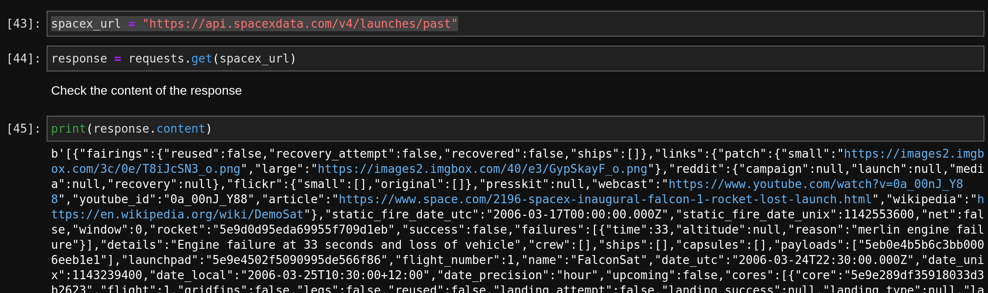
Data Collection – SpaceX API
We made a REST call to the API of SpaceX to get the data we needed to process. The output of the response was a json object that we processed so that we could create a dataframe with our data.
https://github.com/kabikaj/AppliedDataScienceCapstone
1

Slide 9
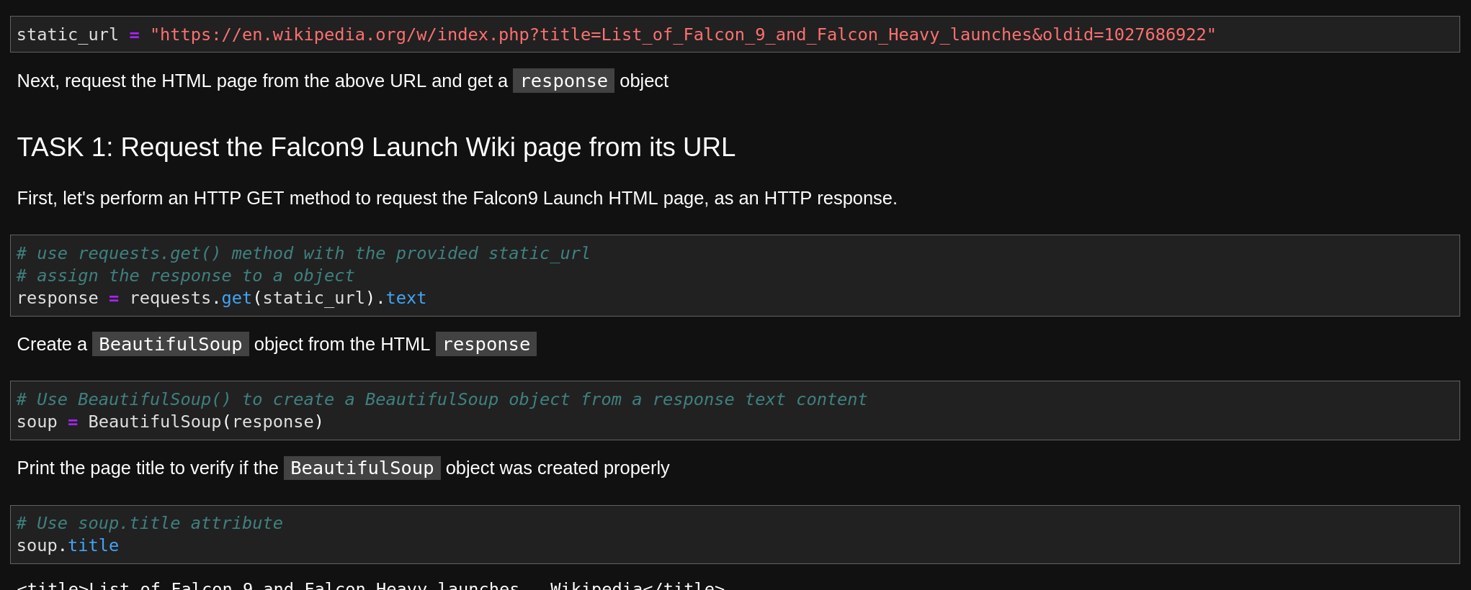
Data Collection - Scraping
We used web scraping and applied a get request to the a wikipedia page to get the data needed for the project and then transform it using beautifulsoup.
https://github.com/kabikaj/AppliedDataScienceCapstone
1

Slide 10
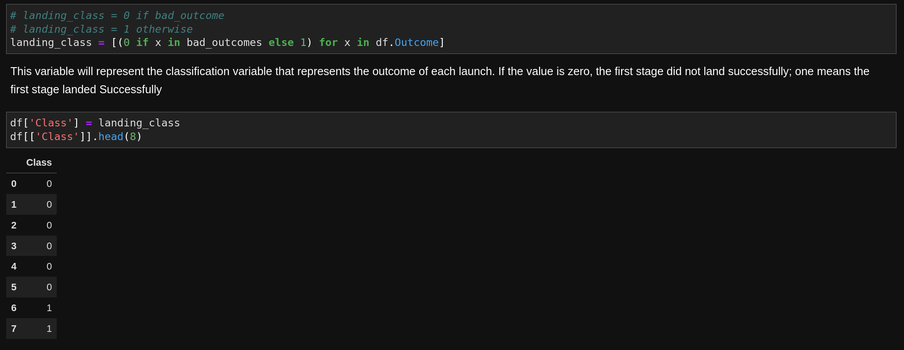
Data Wrangling
The data was converted into a dataframe in order to operate with it. Based on the information available in the data about successes and failures of lauches, we created an additional column in our data, called „class“ and set it to 0 when the lauch was a failure and to 1 when the launch was a success.
https://github.com/kabikaj/AppliedDataScienceCapstone
1

Slide 11
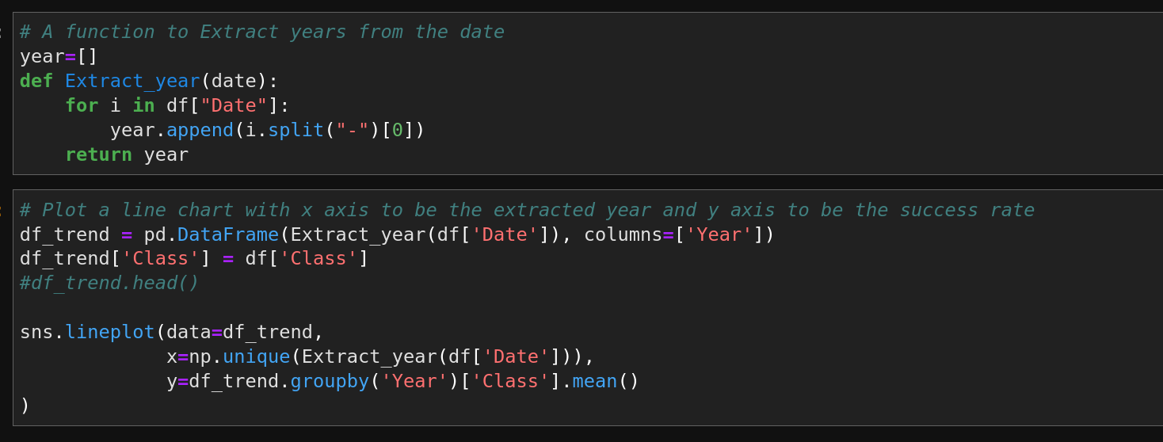
EDA with Data Visualization
We created an extensive amount of different plots and charts iin order to be able to understand our data better. We also perform a one-hot encoding on several fields.
1
https://github.com/kabikaj/AppliedDataScienceCapstone

Slide 12
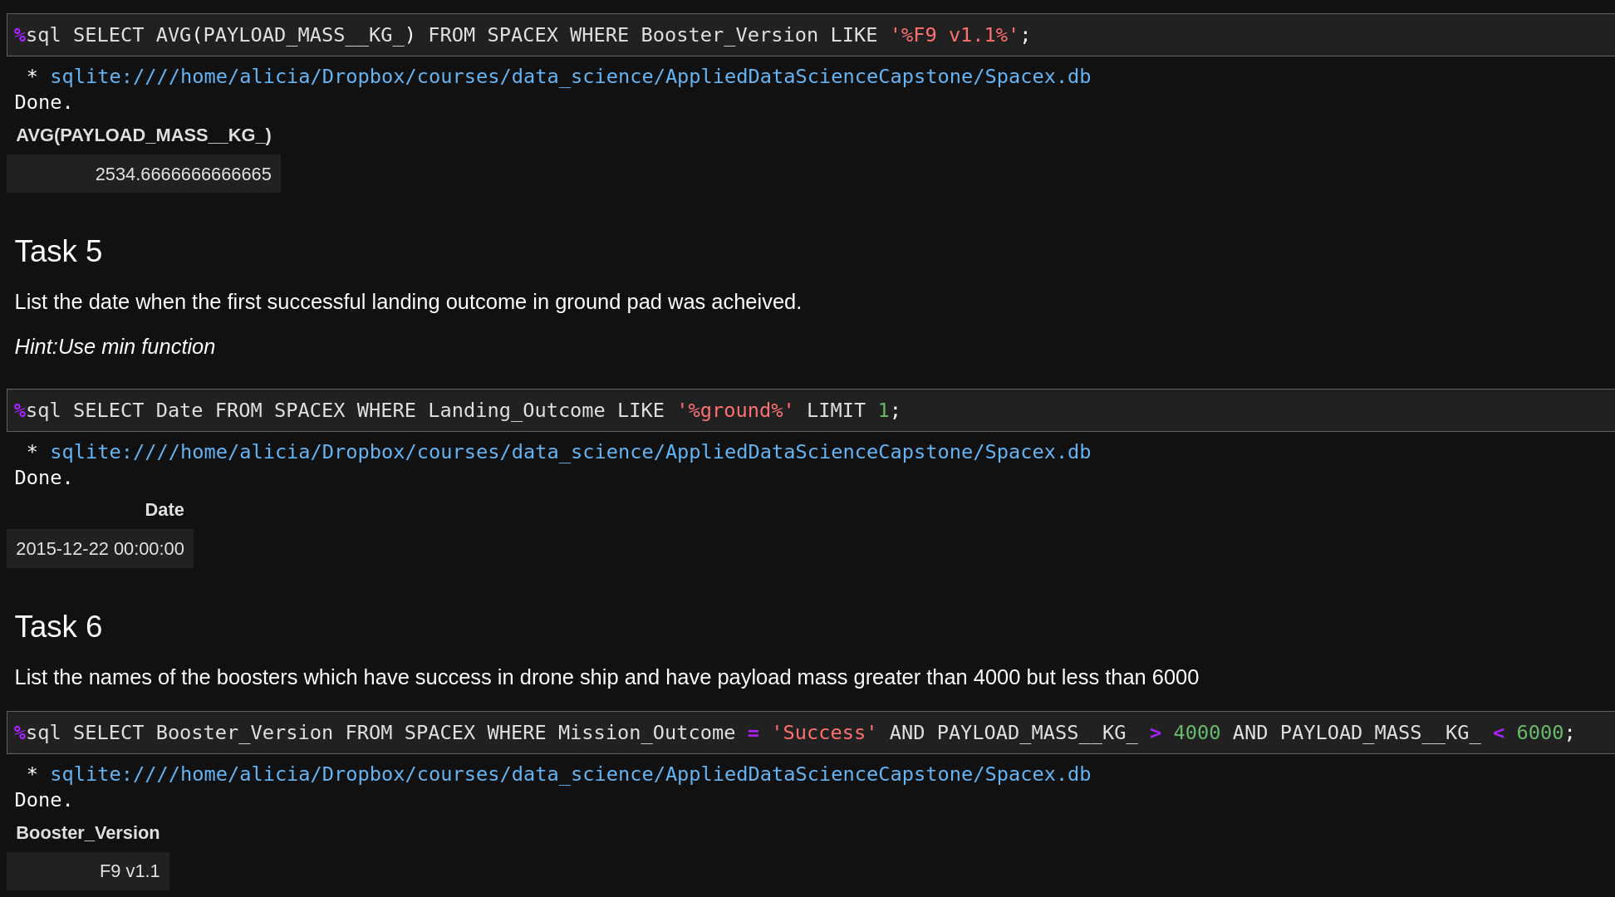
EDA with SQL
We perform an extensive amount of SQL queries in order to explore the data, such as displaying the average payload mass carried by booster version F9 v1.1
1
https://github.com/kabikaj/AppliedDataScienceCapstone

Slide 13
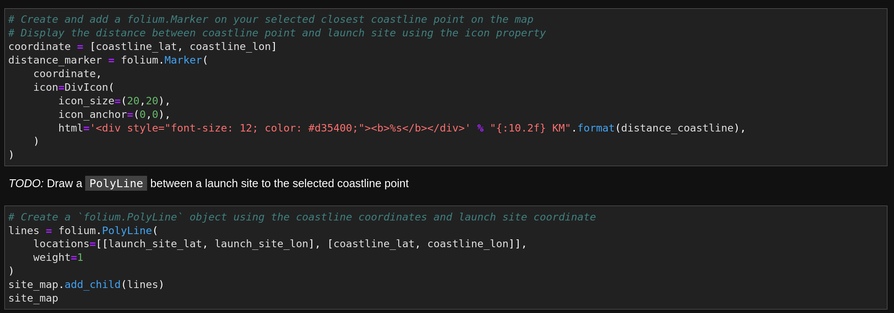
Build an Interactive Map with Folium
The interactive map we created with Folium gave us the possibility to visualise the data from a different perspective, having into account relevant geographical implications. Below you can see a screenshot of part of the code.
1
https://github.com/kabikaj/AppliedDataScienceCapstone

Slide 14
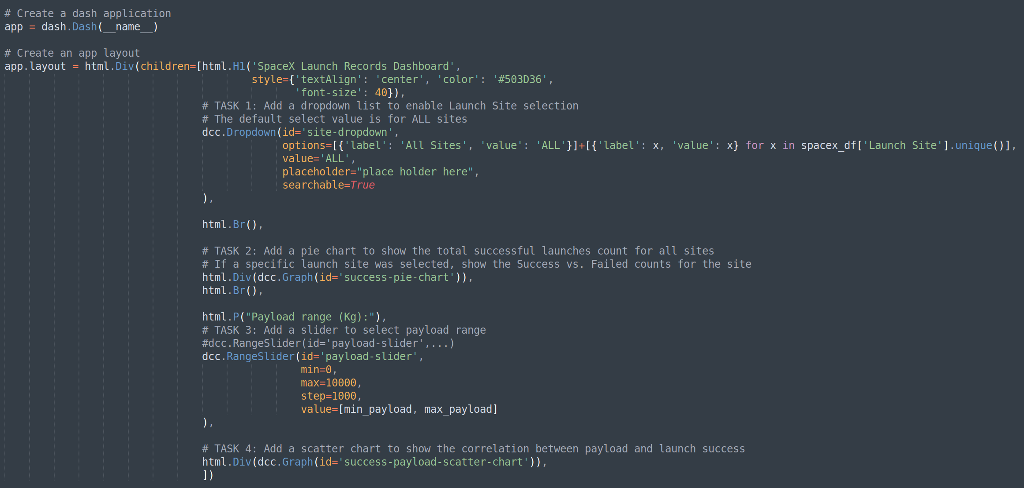
Build a Dashboard with Plotly Dash
With plotly dah we were able to create an interactive dashboard with which we could see different charts by selecting values from menus. Here you can see part of the code.
1
https://github.com/kabikaj/AppliedDataScienceCapstone

Slide 15
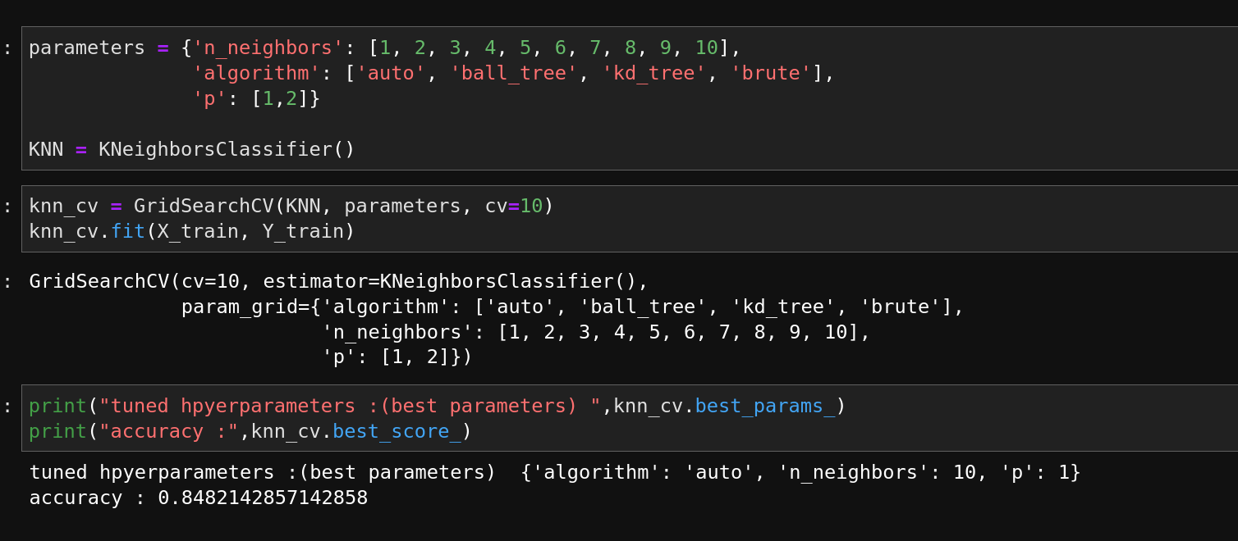
Predictive Analysis (Classification)
The last part of the project consisted of applying differet classification algorithms in order to see if they could predict well the success rates of the launches and which of them was better.
1
https://github.com/kabikaj/AppliedDataScienceCapstone

Slide 16
Results
Exploratory data analysis results
Interactive analytics demo in screenshots
Predictive analysis results
1
Notes:
<number>

Slide 17

Section 2

Slide 18
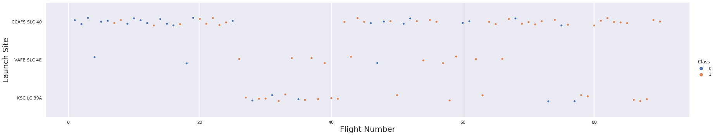
Flight Number vs. Launch Site
As we can see, if the flight numbers are very high we have more successes in all Launch sites
1

Slide 19
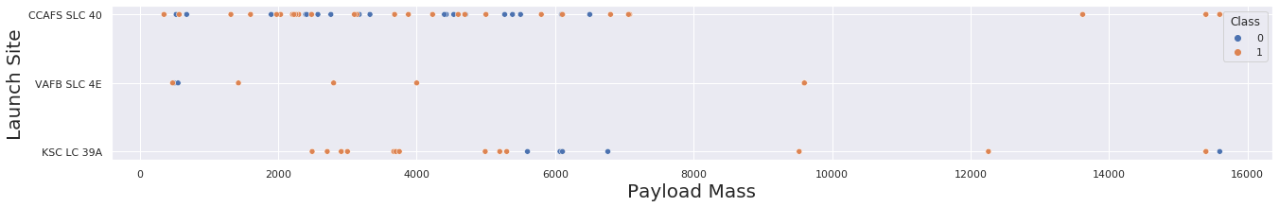
Payload vs. Launch Site
As we can see in the chart, after 8000 of payload mass all launches are succeses.
1

Slide 20
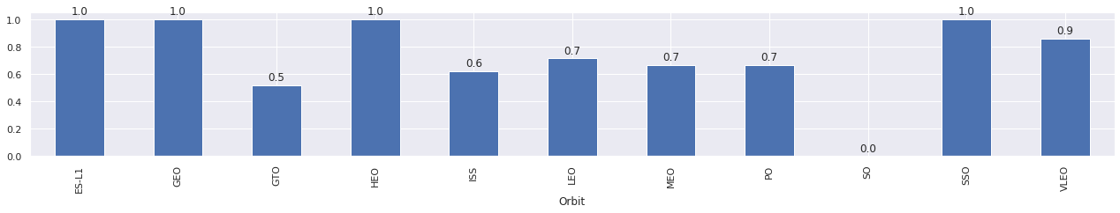
Success Rate vs. Orbit Type
As we can see in the chart below, ES-L1, GEO, HEO and SS0 orbit types have a sucess rate of 1.
1

Slide 21
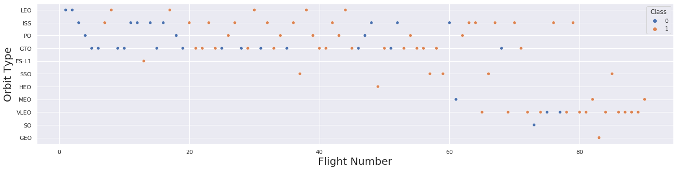
Flight Number vs. Orbit Type
In general we can see that the more flight numbers, the more the successes.
1

Slide 22
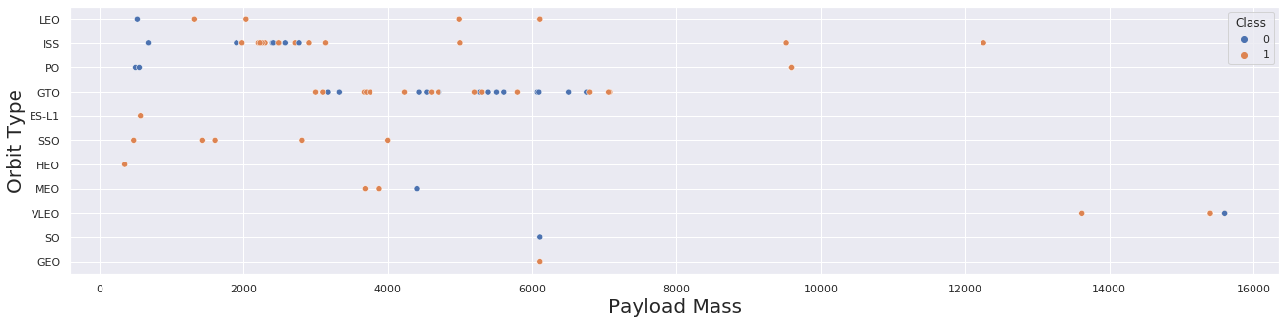
Payload vs. Orbit Type
We cannot see any remarkable tendency from this chart.
1

Slide 23
Launch Success Yearly Trend
The sucess rate since 2013 kept increasing till 2020
1

Slide 24
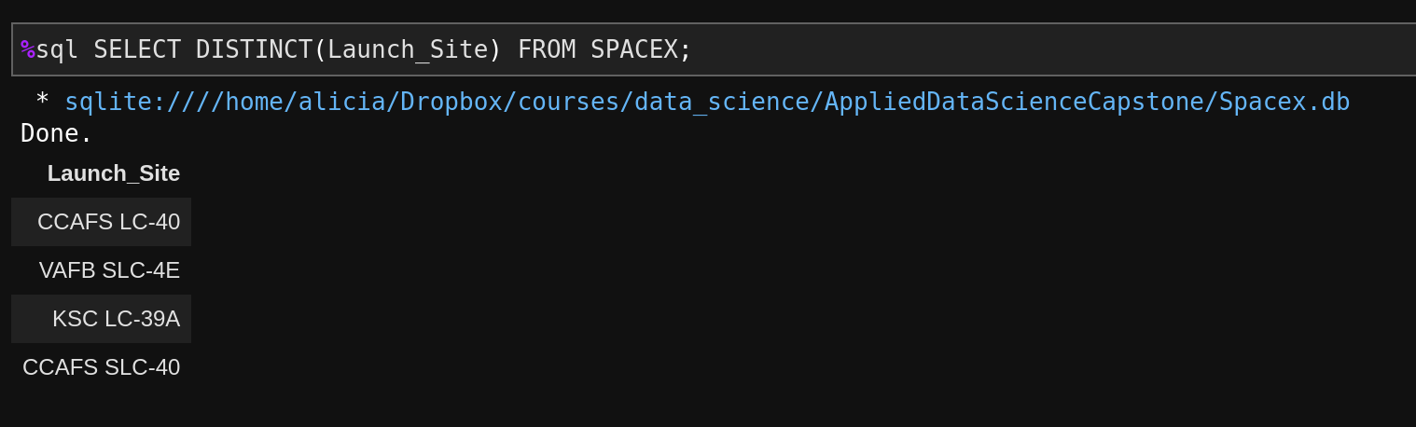
All Launch Site Names
We apply the distinct method to the Lauch_Site data to get the result.
1

Slide 25
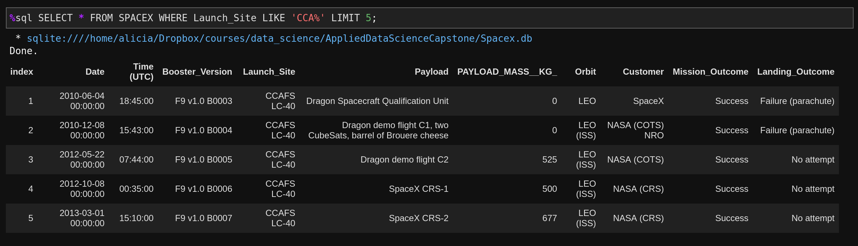
Launch Site Names Begin with 'CCA'
We used the where and like sql command and limit our results to 5.
1

Slide 26
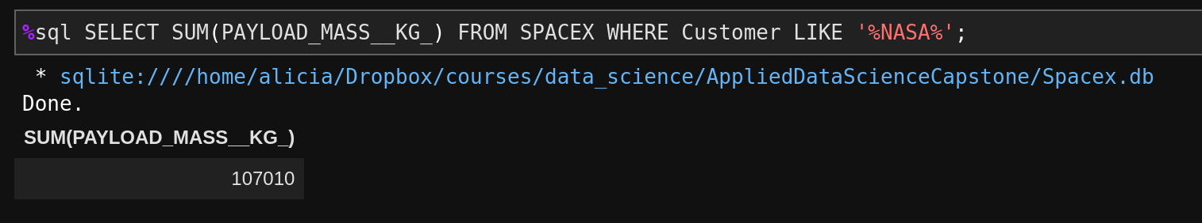
Total Payload Mass
For getting the total payload mass by NASA we filtered our results first and them applied the sum method.
1

Slide 27
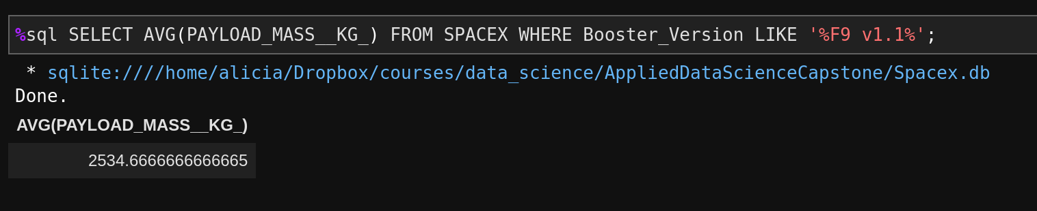
Average Payload Mass by F9 v1.1
In this case we used the method avg to get the average.
1

Slide 28
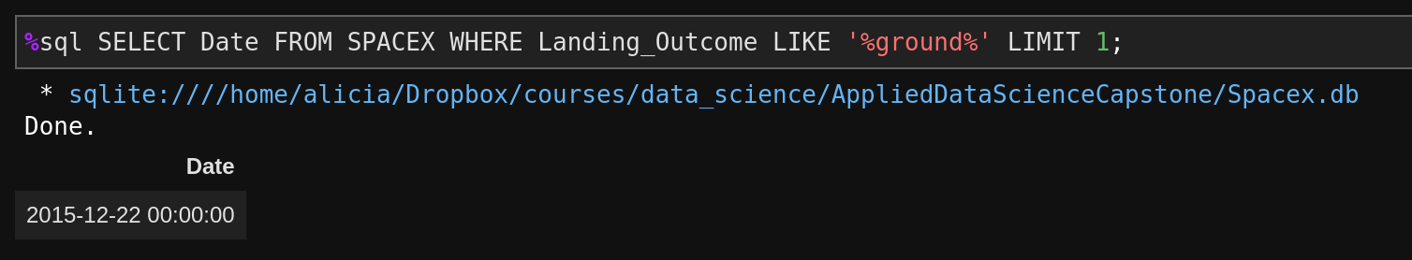
First Successful Ground Landing Date
We filtered our data and limit the results to 1.
1

Slide 29
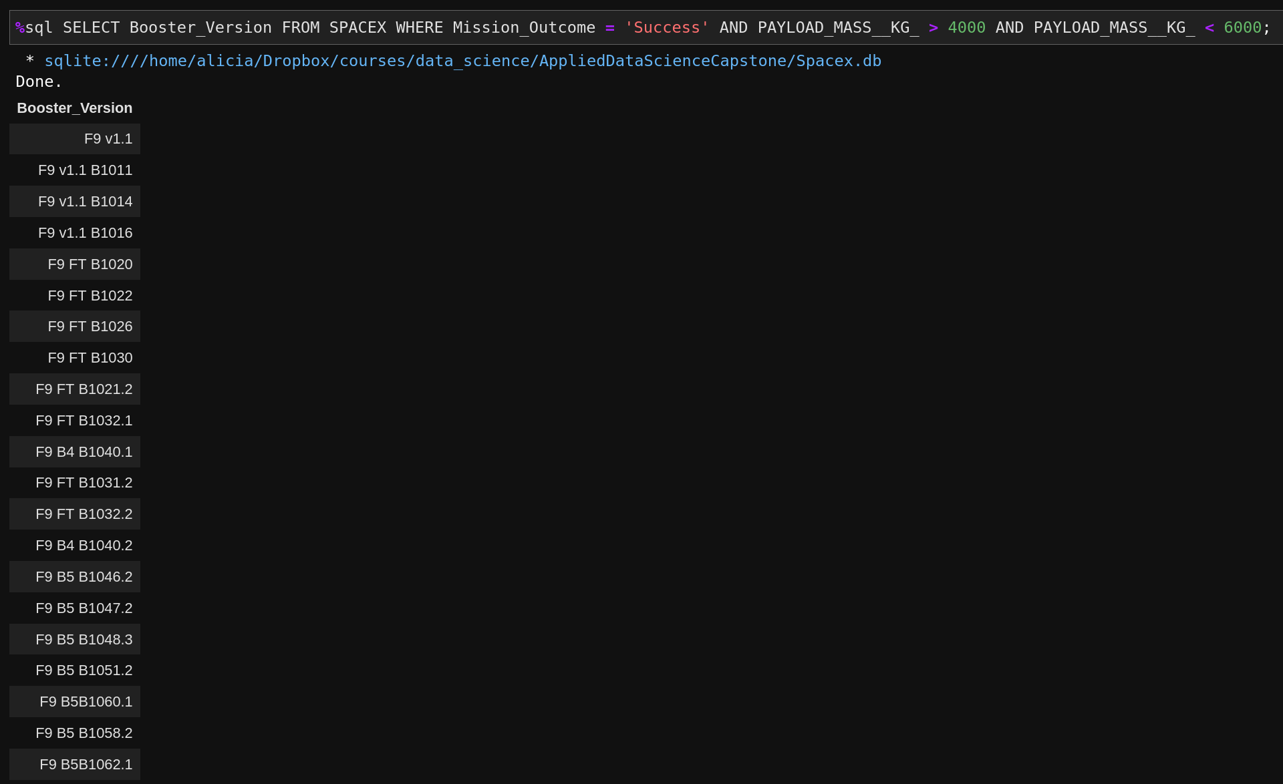
Successful Drone Ship Landing with Payload between 4000 and 6000
We applied again several filters to get our result
1

Slide 30
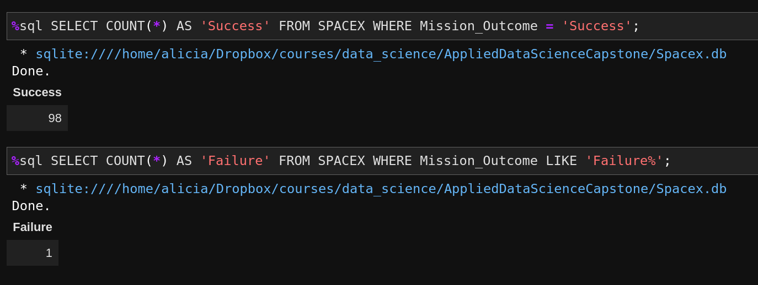
Total Number of Successful and Failure Mission Outcomes
We used the method count to count both cases.
1

Slide 31
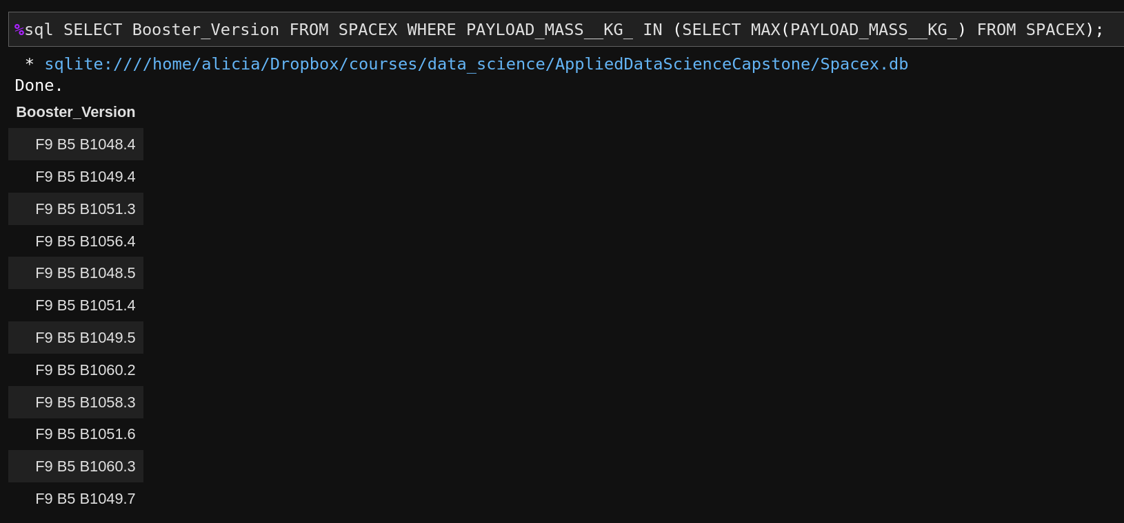
Boosters Carried Maximum Payload
In this case we used a subquery to get our results.
1

Slide 32
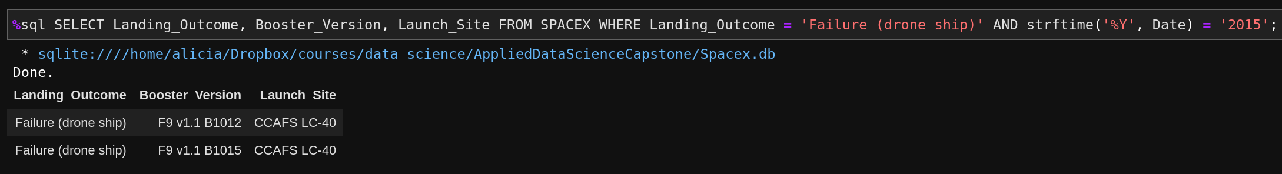
2015 Launch Records
For this query, we had to apply a method to extract the year from the date value.
1

Slide 33
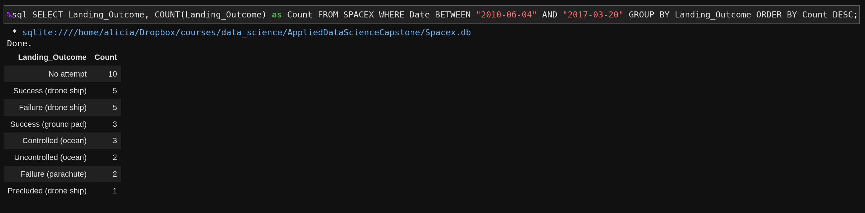
Rank Landing Outcomes Between 2010-06-04 and 2017-03-20
In this last query we used a group by and then ordered our results in descdnding order.
1

Slide 34

Section 3

Slide 35
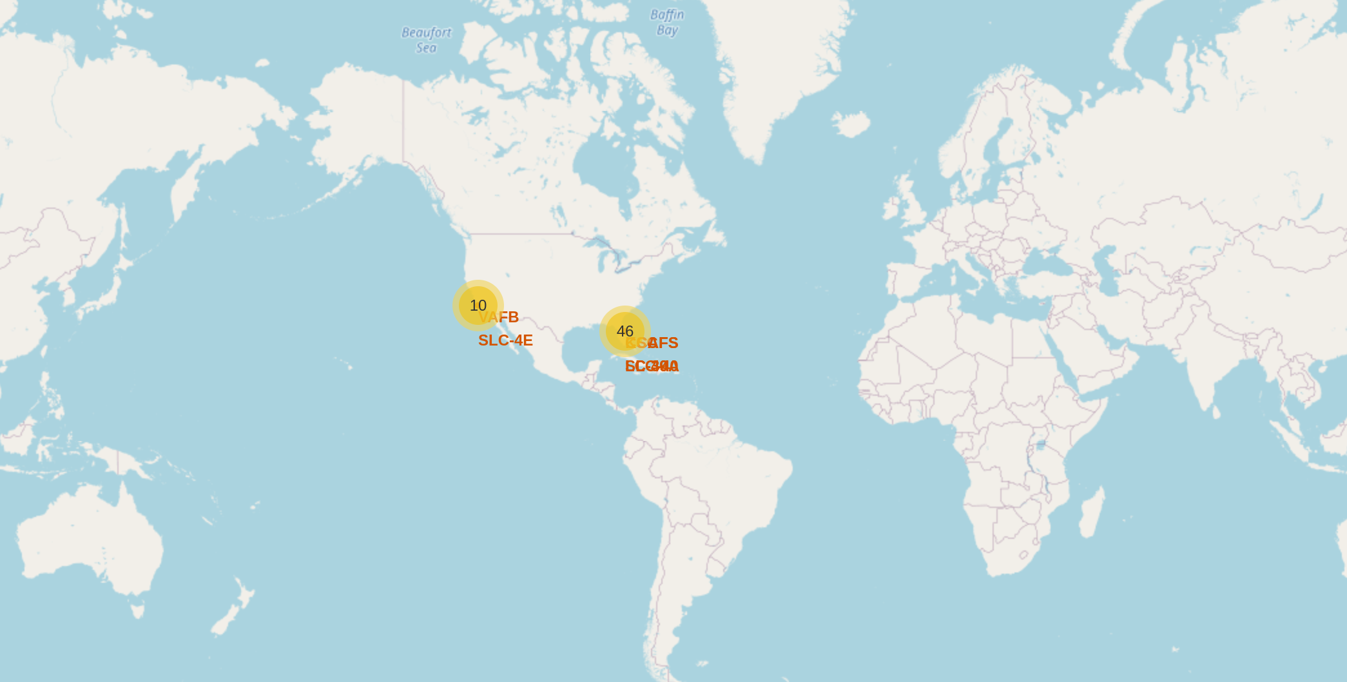
Folium Map: global map with all launch sites
Here we can see a global map including all launch sites’ location markers.
1

Slide 36
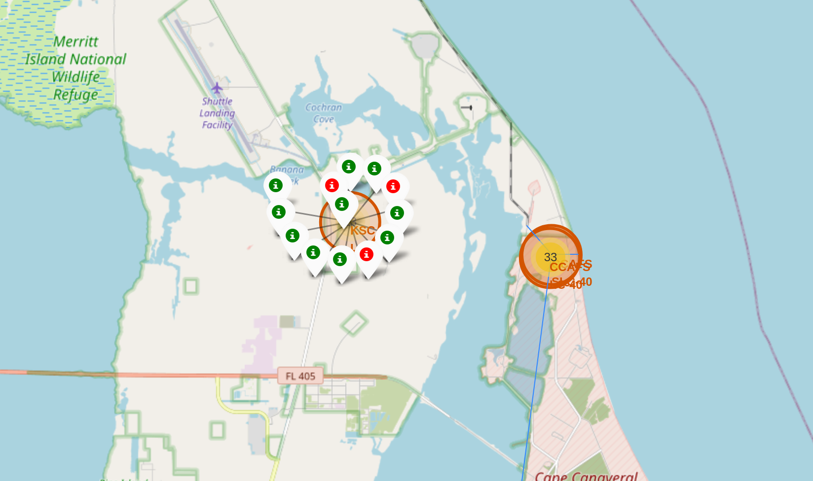
Folium Map: color-labeled launch outcomes
Here we can see the color-labeled launch outcomes in one of the sites.
1

Slide 37
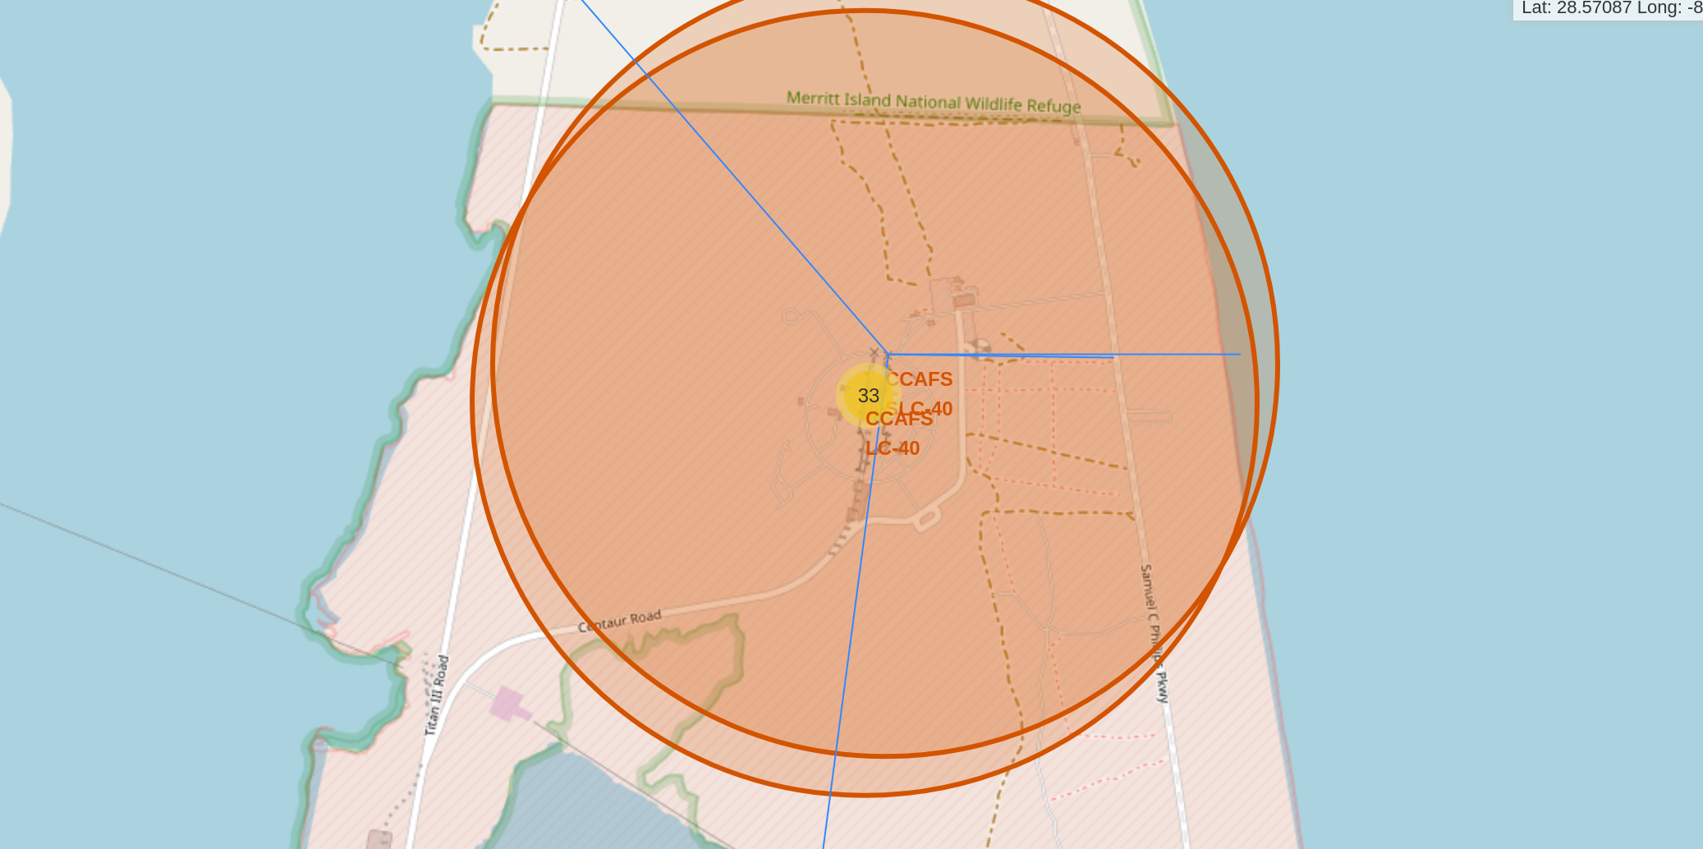
Folium Map: proximities of a launch site
Here we can see a zoom in of a launch site.
1

Slide 38

Section 4

Slide 39
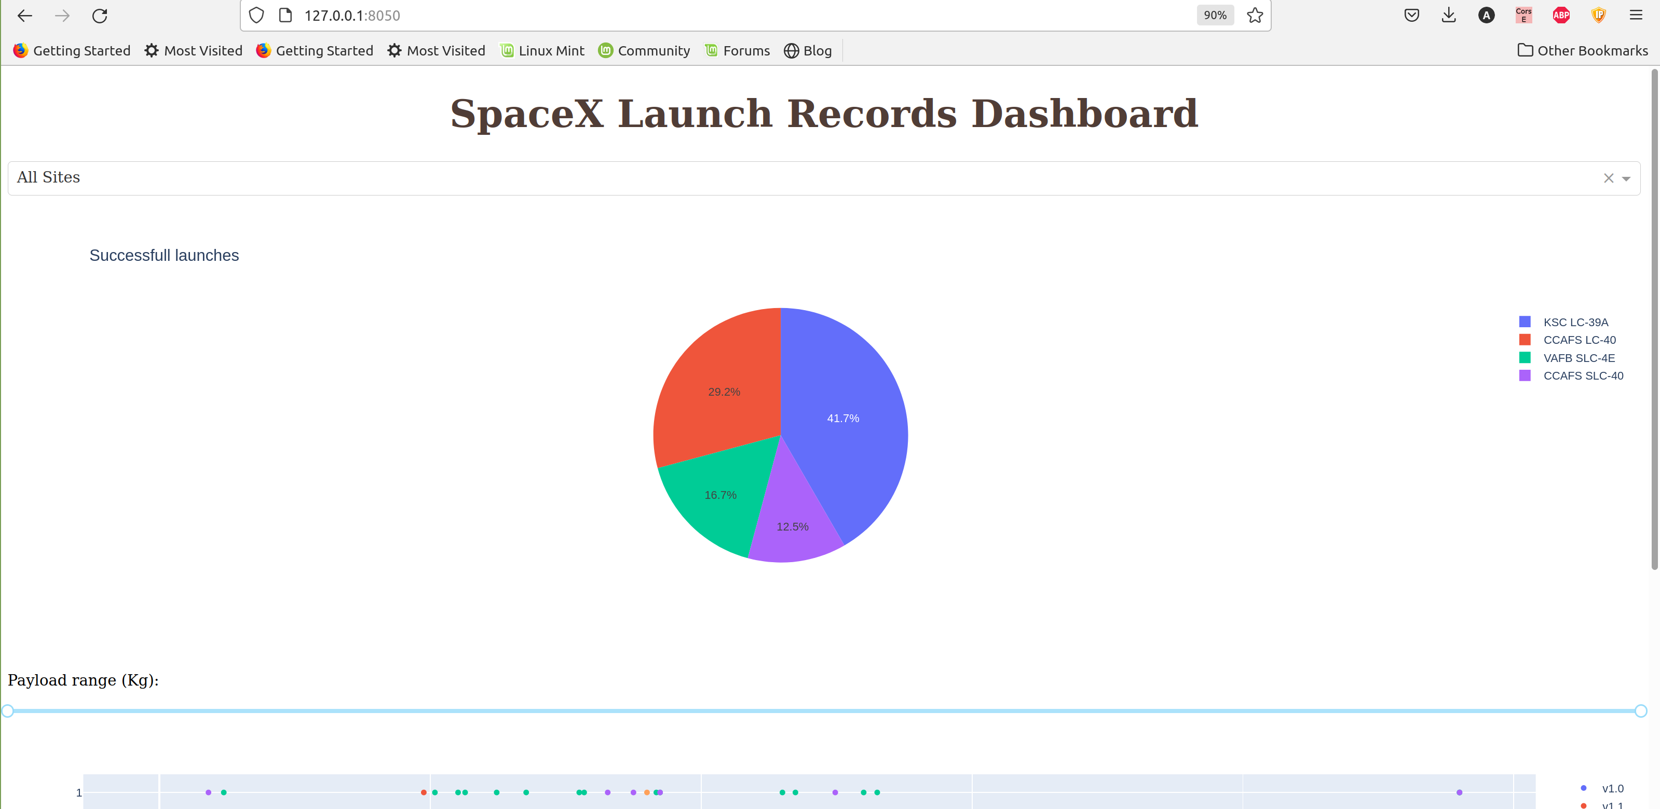
Dashboard: Succesfull launches
As we can see, the KSC LC-39A Site has the biggest amount of successfull launches.
1

Slide 40
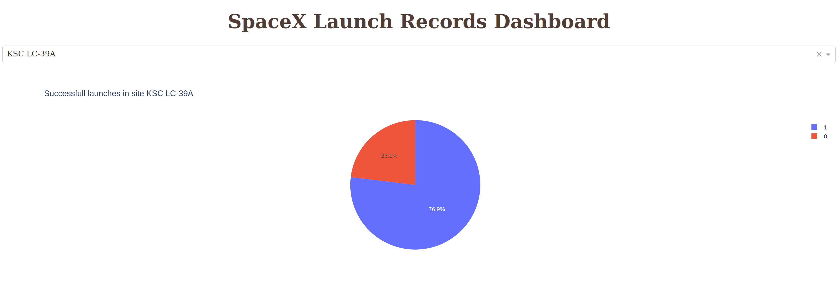
Dashboard: Launch site with highest launch success ratio
As we can see, KSC LC-39A has a success rate of 76.9%.
1

Slide 41
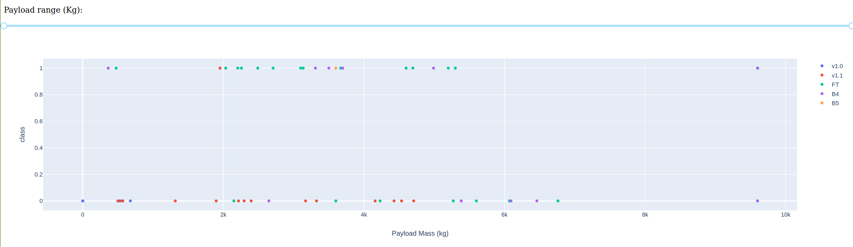
Dashboard: Payload vs Launch Outcome
As we can see, between 2k and 6k we have most of the values for FT and the majority of them belong to the success class.
1

Slide 42

Section 5

Slide 43
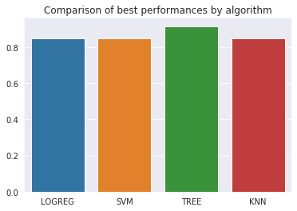
Classification Accuracy
As we can see, the decision tree model has slightly better accuracy than the rest
1

Slide 44
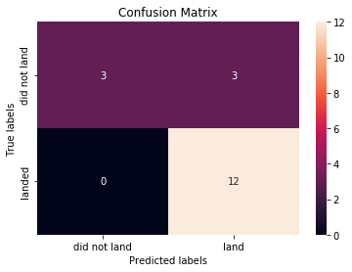
Confusion Matrix
All algorithms showed the same confussion matrix. As we can see, they predicted correctly all the cases where there was not landing, so there are no false positives. But we have cases of false negatives, so the algorithm predicted a landing but there was no.
1

Slide 45
Conclusions
We saw that if the flight numbers are very high we have more successes in all Launch sites
After 8000 of payload mass all launches are succeses.
ES-L1, GEO, HEO and SS0 orbit types have a sucess rate of 1.
All machine learning algorithms we applied perfomed well in predicting the right class, but the decision tree has slighly better accuracy
1

Slide 46
Appendix
All code can be find in the github project https://github.com/kabikaj/AppliedDataScienceCapstone
1
Notes:
<number>

Slide 47


